Slide 1
DHI-WASY Software Training
Modeling Subsurface Flow and Transport using FEFLOW 7.0

Slide 2
Free vs. Forced Convection
DHI - WASY Software Training

Slide 3

Exercise 1: Free vs. Forced Convection
Salt Intrusion From the Top
Vertical cross section

Slide 4
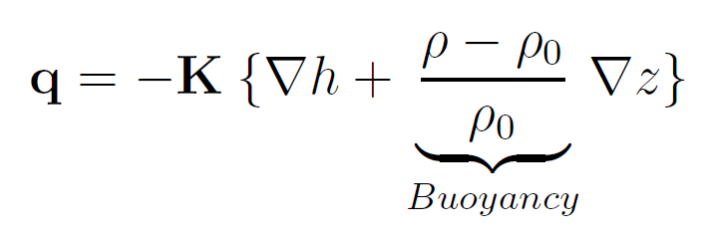
Background
Pressure- vs. density-induced flow

Slide 5
Spatial Discretization
Dimensionless Characteristics
Forced convection (Peclet number)
Free convection (Rayleigh number)

Slide 6
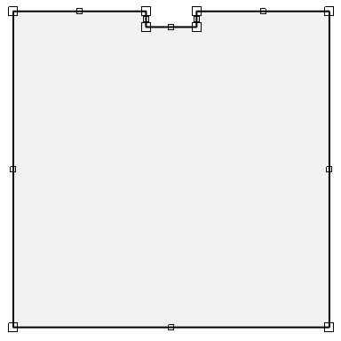
Spatial Discretization – Supermesh Setup
(42,0)
(58,0)
(0,0)
(100,0)
(42,-5)
(58,-5)
Height 100 m
Width 100 m
(0,-100)
(100,-100)

Slide 7
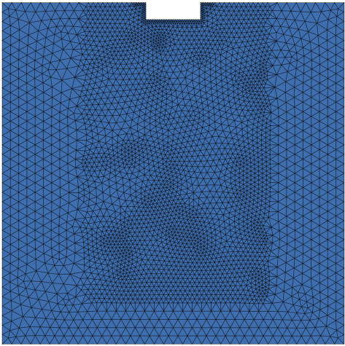
Spatial Discretization
Mesh Generation
Mesh generation with ~3000 (triangular elements)
Local mesh refinement (via Select in Rectangular Region and Select Nodes along a Border tools)

Slide 8
Model Setup
Problem Settings:
Projection: Vertical, planar (confined)
Problem Class: Fluid flow and mass transport
State: Steady fluid flow, transient transport
Simulation-Time Control: Automatic time stepping, FE/BE time integration, final time: 120,000 days (~330 years)
Solver Settings: Direct equation solver (PARDISO)

Slide 9
Model Setup
Material Properties: Flow
Density Ratio α:

Slide 10
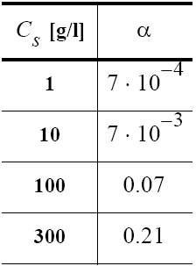
Model Setup
Material Properties: Flow
Relation between solute concentration and density:
Density ratio α = 10⁻³

Slide 11
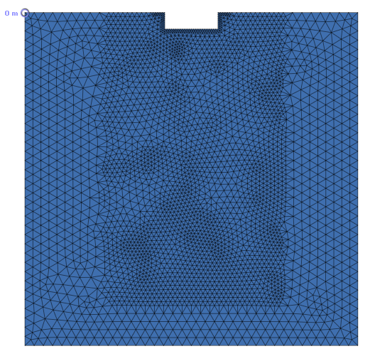
Model Setup
Boundary Conditions: Flow
Impermeable border (default)
Hydraulic-head BC at an arbitrary node, e.g., upper left: h = 0 m

Slide 12
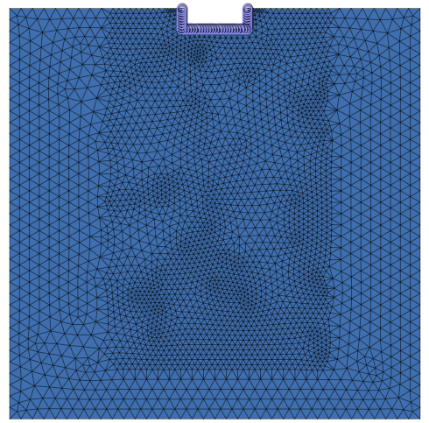
Model Setup
Boundary Conditions: Mass
Concentration at the
spill site: 100 mg/l
Mass-concentration BC along the spill-site border (via Select Nodes Along a Border tool): C = 100 mg/l

Slide 13
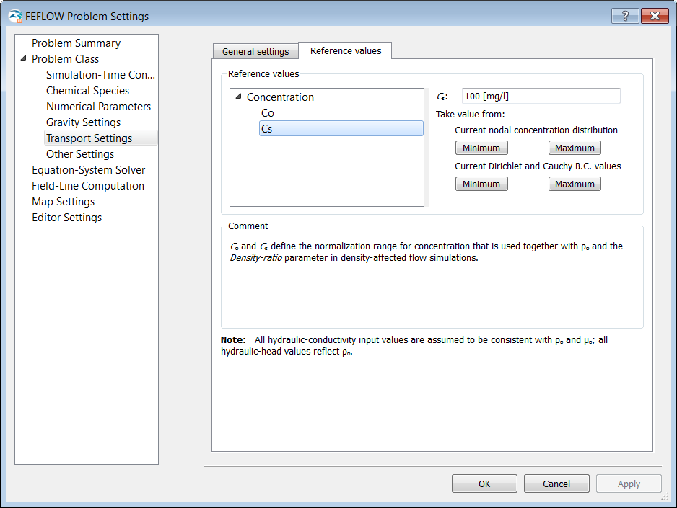
Problem Settings
Reference Values
Set maximum
concentration C_{s} to 100 mg/l:

Slide 14
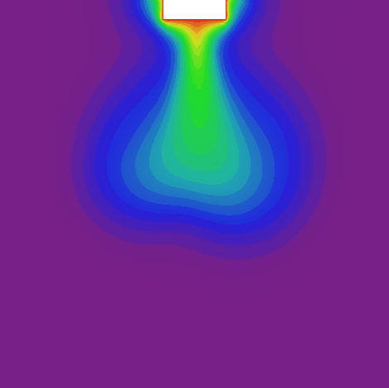
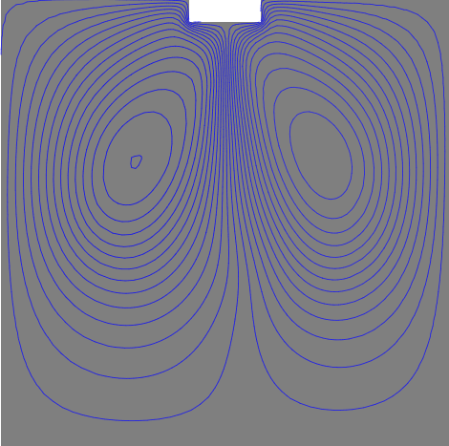
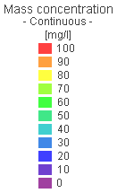
FEFLOW Result
Free convection

Slide 15

Base Model – Save…

Slide 16
Model Extension
Head gradient
Horizontal hydraulic gradient (‘strong’)
Implemented as hydraulic-head BC along the left and right vertical borders (Select Nodes along a Border):
• Left side: h = 0 m
• Right side: h = 0.1 m

Slide 17
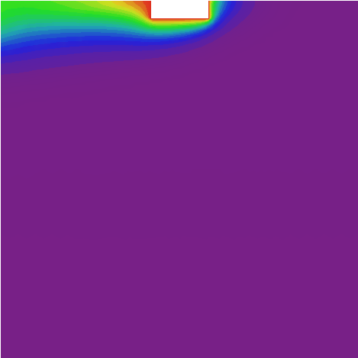
FEFLOW Result
Flow is dominated by forced horizontal convection

Slide 18
FEFLOW Results
Horizontal hydraulic gradient (‘weak’)
Reducing the boundary-condition value on the right vertical border (Select Nodes Along a Border):
• Right side: h = 0.01 m

Slide 19
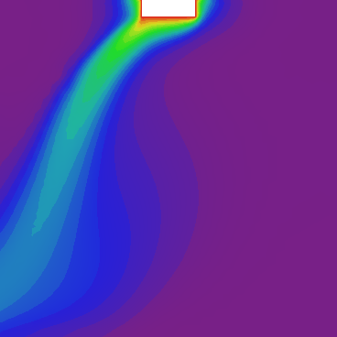
FEFLOW Results
Combined effects of free and forced (mixed) convection

Slide 20
Geothermal application
DHI - WASY Software Training

Slide 21
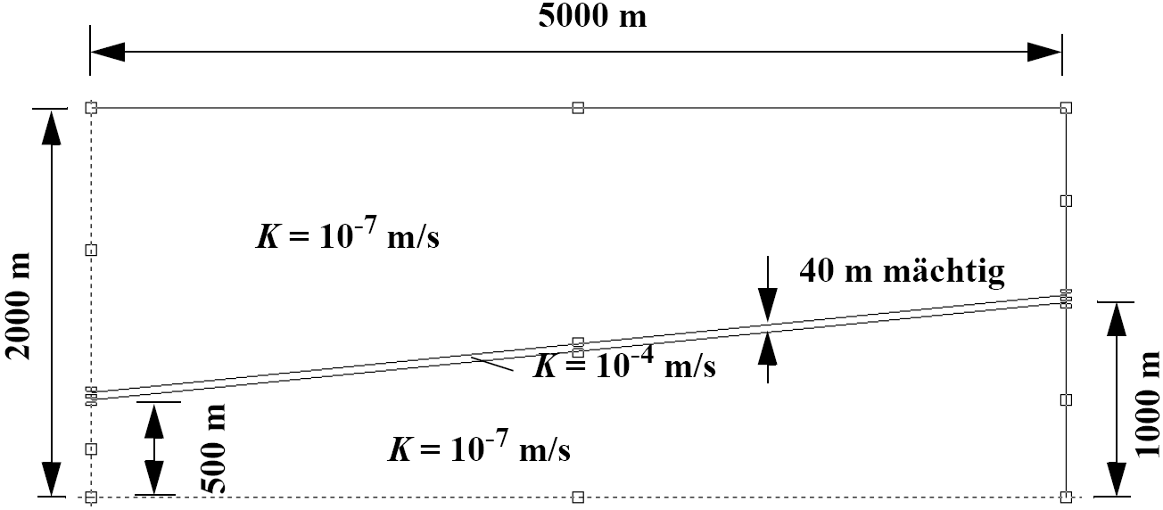
Exercise 3: Geothermal Application
Heat extraction from a sloped sandstone aquifer
Salt Intrusion From the Top
Vertical cross section of the model domain

Slide 22
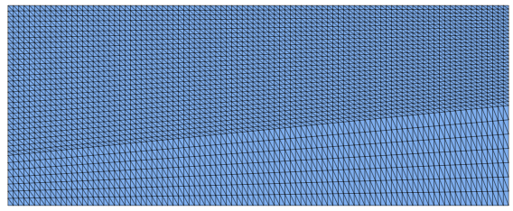
Spatial discretization
Mesh generation 1
3 supermesh polygons
Transport mapping with 3000 quad elements, option Triangulation

Slide 23
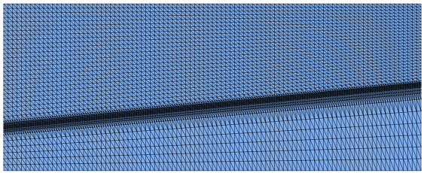
Spatial Discretization
Mesh generation 2
Local refinement within sloped aquifer
Supermesh Polygons > Select by Map Polygons, Set Snap distance = 0 m
Refine elements twice

Slide 24
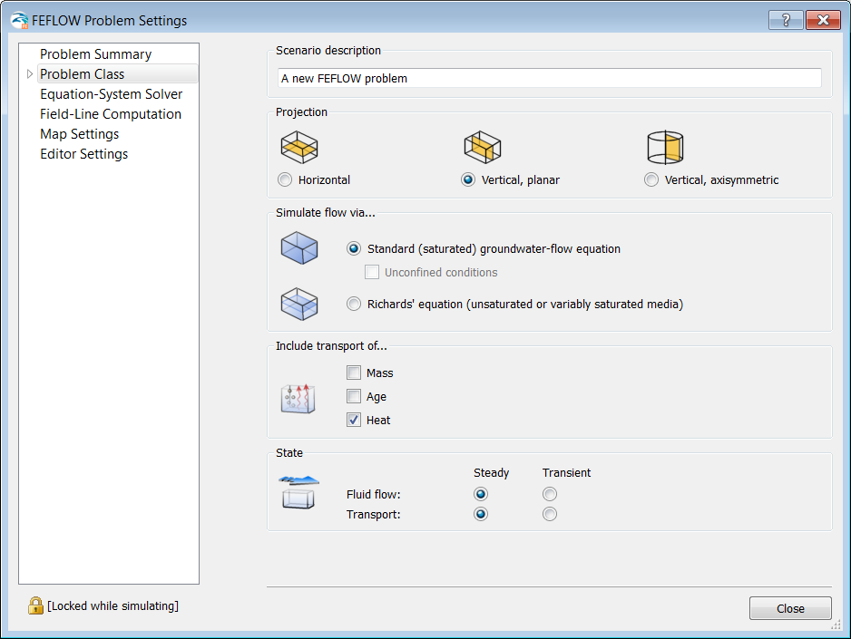
Model Setup
Problem Settings:
Projection: 2D vertical, planar
Problem Class: Flow and heat transport
State: Steady flow and transport
Solver: Direct Equation Solver

Slide 25

Model Setup
Material Properties: Flow
Hydraulic Conductivity:
  1E-7 m/s globally
  1E-4 m/s within the sloped aquifer (select elements by map polygon)

Slide 26
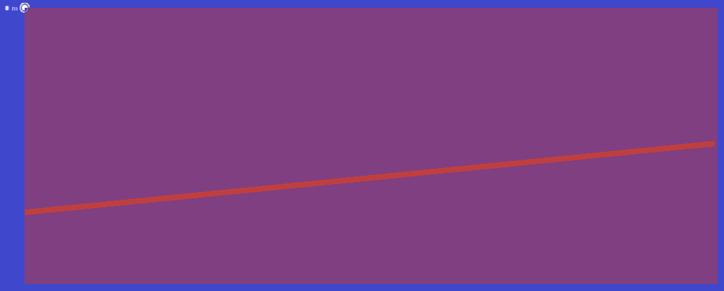
Model Setup
Boundary Conditions: Flow
Impermeable boundaries (default)
One hydraulic-head B.C. at an arbitrary node, upper left border, h = 0 m

Slide 27
Model Setup
Boundary Conditions: Heat
Geothermal gradient: 35 K/km
Implemented as temperature boundary condition on the top and bottom border (Select nodes Along a Border tool)
        Top: T = 20°C
        Bottom: T = 90°C

Slide 28
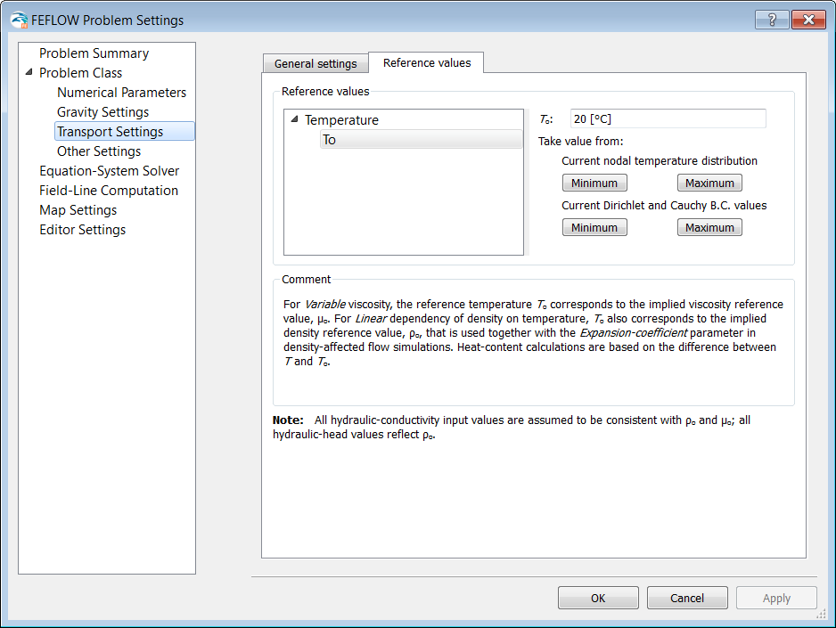
Model Setup
Reference Values
Reference Temperature
T₀ = 20° C

Slide 29
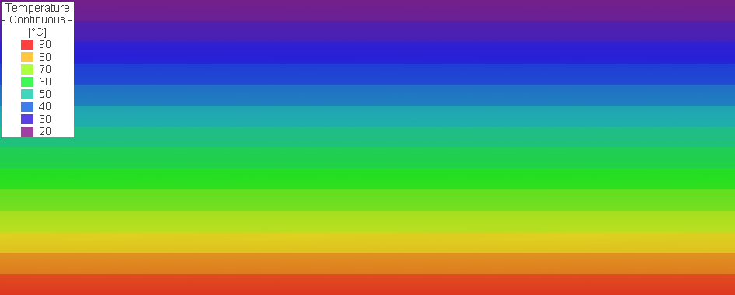
FEFLOW Result
Conductive Temperature Distribution
→ Save as Base model!

Slide 30
Model Extension
Problem Settings
State: Transient flow, Transient transport
Simulation-Time Control:
  Automatic time-step control
  First-order accurate (FE/BE integration)
  Final simulation time: 36500 days (100 years)
  Error tolerance: 0.1* [10⁻³], Maximum Error Norm

Slide 31
Model Extension
Boundary Conditions
Remove h = 0 m hydraulic-head B.C. that was needed for steady-state computation

Slide 32
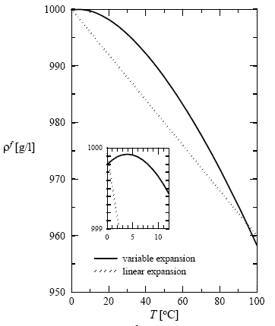
Model Extension
Global:
Expansion coefficient
β = 0.0004 K⁻¹
→ Input 4 [10⁻⁴] K⁻¹
Water density as a
function of temperature

Slide 33
Base Model – Save…

Slide 34
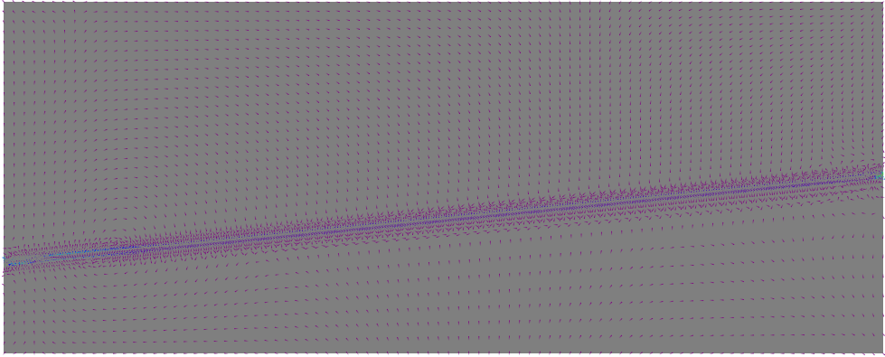
FEFLOW Result
➔ No convection cells

Slide 35
Model Extension
Material Properties: Flow
Aquifer of higher hydraulic conductivity:
    Conductivity [max] = 50 [10⁻⁴ m/s] (Select by map polygon with Supermesh polygons as selection map)

Slide 36
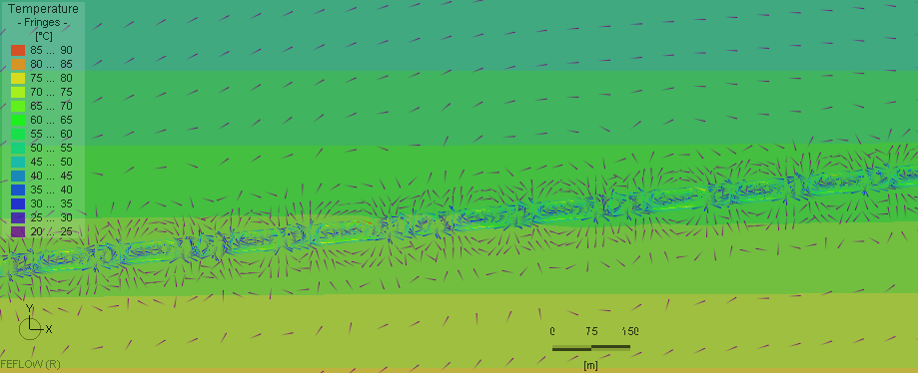
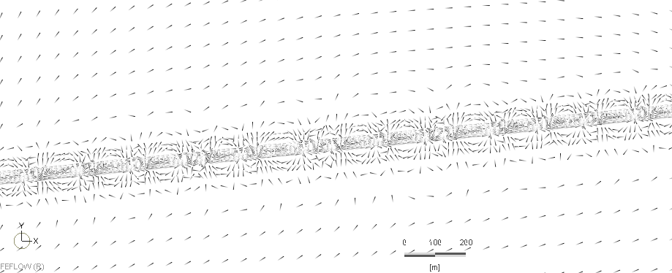
FEFLOW Result
Convection cells develop in aquifer

Slide 37
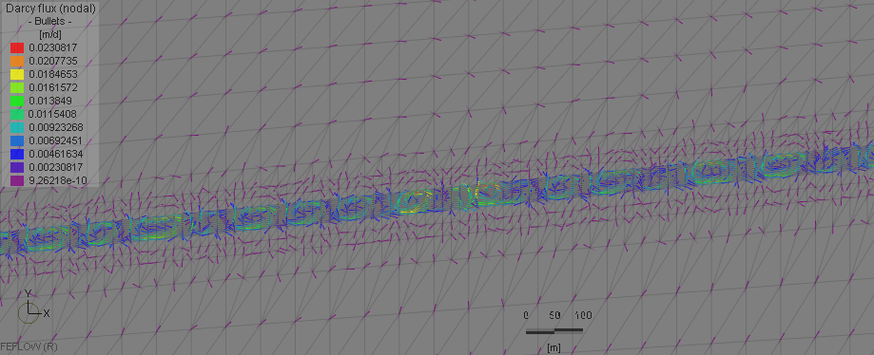
FEFLOW Result
Convection cells develop in aquifer

Slide 38
Load Model – Save…

Slide 39
Model Extension
Boundary Conditions
Pumping rate of 250 m³/h, or 6000 m³/d, over 500 m system width: 12 m²/d (2D)
Distributed vertically over 40 m aquifer height, the outflux due to pumping is 0.3 m/d
An inner Neumann-B.C. acts in two directions
simultaneously, thus the B.C. value is half the flux:
q = 0.15 m/d
Pumping (heat extraction) from aquifer and re-injection (of cooled water) into aquifer

Slide 40
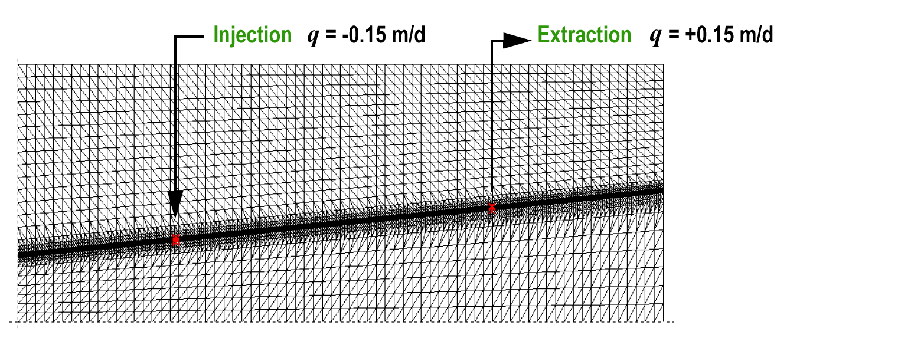
Model Extension
Boundary Conditions
Set 2nd-kind B.C.s (via Select Individual Mesh Items):
Save the respective node selection for both B.C.s (via the context menu of the Spatial Units panel)

Slide 41
Model Extension
Boundary Conditions
Temperature of re-injected water: 20°C
Implemented as 1st-kind B.C. at injection nodes:
T = 20°C

Slide 42
Model Extension
Problem Settings
  State:
    Transient flow, transient transport
Simulation-Time Control:
  Final simulation time: 20000 days

Slide 43
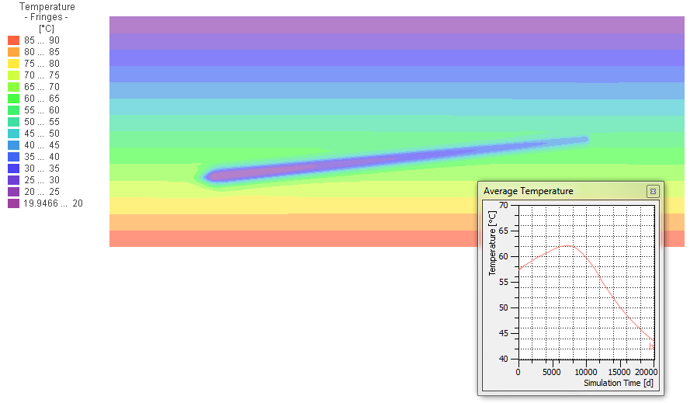
FEFLOW Result

Slide 44
Model Extensions
Boundary Conditions:
Delete flux BC and injection temperature BC
Set observation point at outlet position
Problem Settings
Final time: 1,000,000 days

Slide 45
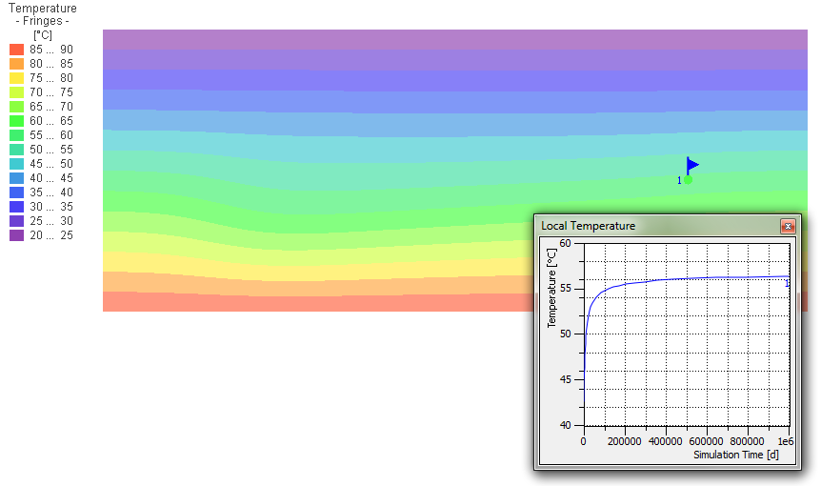
FEFLOW Result

Slide 46
Thank you

